Slide 1
The Battle of Neighbourhoods Final
Presented by : Vishal Chavan

Slide 2
1. Introduction
Background: All the people over the world love to dine in different restaurants. Here, we would like to set up new Indian Restaurant in London with multiple varieties.
Problem: This Project aim to select the borough in London based on their popularity, explore the neighborhoods of that borough to find the common venues in each neighborhood and finally cluster the neighborhoods using K-means clustering.
Target: Considering the diversity in London where most people are multireligion based. London is a place where different shades live. Definitely, by looking at the population we can determine there is highly shortage of Indian restaurants in London.

Slide 3
2. Data acquisition and cleaning:
Data Acquisition: The Data acquired for this project is a combination of data from 2 different sources:
There first data source of the project used a London areas that shows data of borough In London.
The second source of data is demographic of London where we can see demography of the people living in London.
Data Cleaning: The Data cleaning process for each source of data are done separately.
From London list of areas, it will shows London borough with postal town and postal code which are then pivoted to check total numbers.
Demography of London where we have sorted white, black, mixed, Asian to check how much count in each location in London
Latitude and Longitude are obtained and join with location which will help us to identify the distance

Slide 4
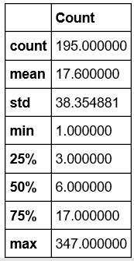
3. Methodology
Exploring Data Analysis:
The Describe function in python is used to get statistic of the London areas, this return the mean, standard deviation, minimum, maximum, 1st Quantile (25%), 2nd Quantile (50%), 3rd Quantile (75%) for each of the major categories
Count in Diagram shows venue unique counts describe in categories of venues.

Slide 5
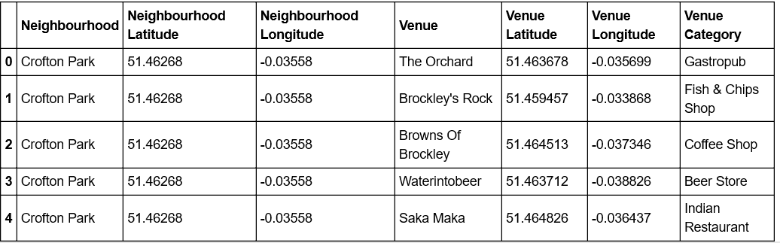
Methodology Cont…….
Modelling:
Using Final data set containing the neighbourhood in London with latitude and longitude, we can find all venues within a 500meter radius of each neighbourhood by connecting to the Foursquare API
One hot encoding is done on the venues data. The venues data is then grouped by neighbourhood and the mean of the venues are calculated, finally 10 common venues are calculated for each neighbourhoods.
To help people find similar neighbourhoods in the borough we will be clustering similar neighbourhoods using K –means clustering which is a form of unsupervised machine learning algorithm that clusters data based on predefined cluster size

Slide 6
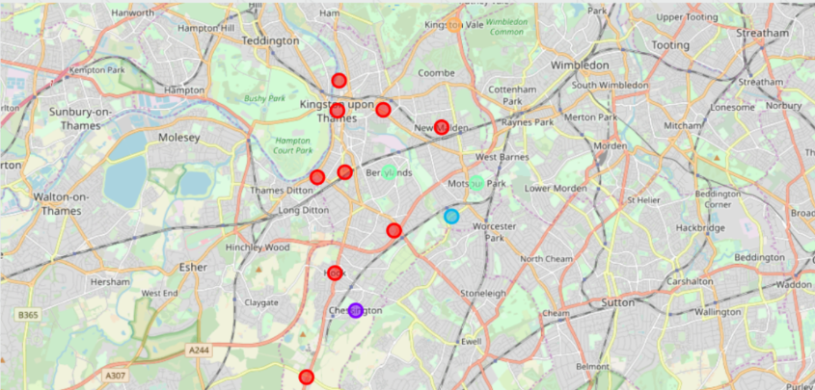
4.Results
After running the K-means clustering we can access each cluster created to see which neighbourhoods were assigned to each of the five cluster.
To find the optimal value of the number of clusters, k, the number of clusters is iterated corresponding Silhouette Coefficientis calculated for each of the k-values used.

Slide 7
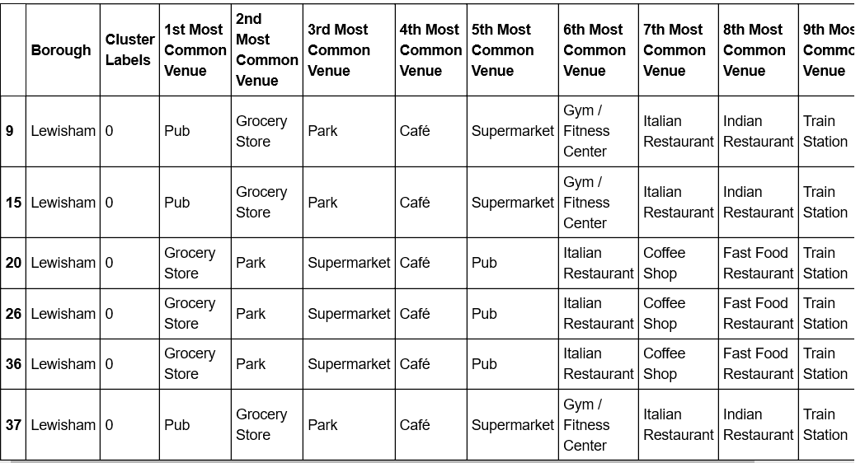
Results Cont……..
Cluster 1:
Upon looking these neighborhoods we can see most common venues in these neighborhoods ae pubs and Restaurants

Slide 8
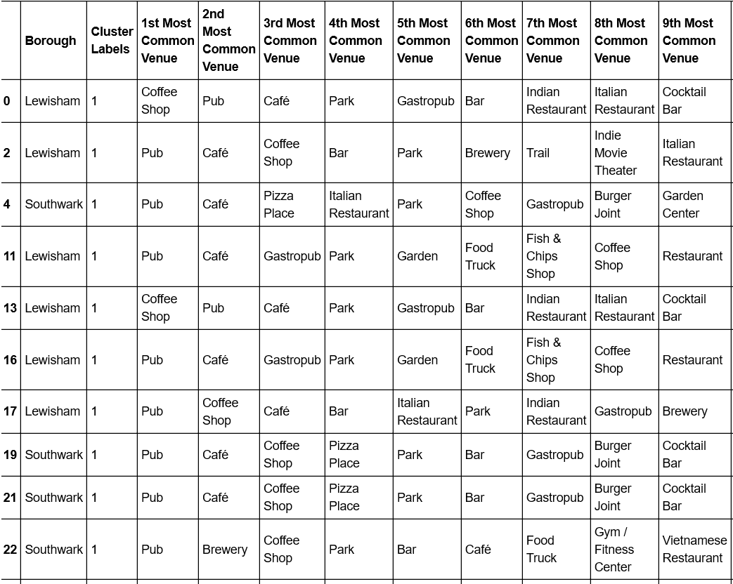
Results Cont……..
Cluster 2:
The second cluster has neighbourhoods which consists of venue CAFÉ, Pubs, Park

Slide 9
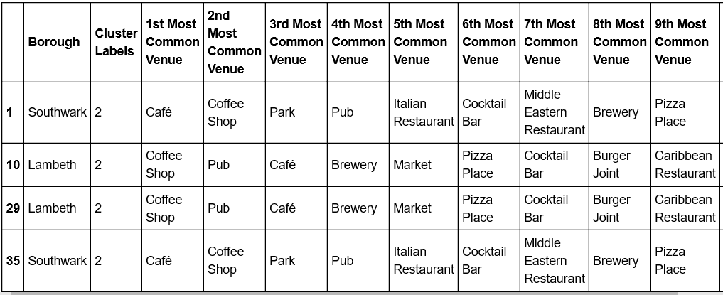
Results Cont……..
Cluster 3:
The third cluster has neighbourhoods which consists of venue Coffee shops, Pubs.

Slide 10
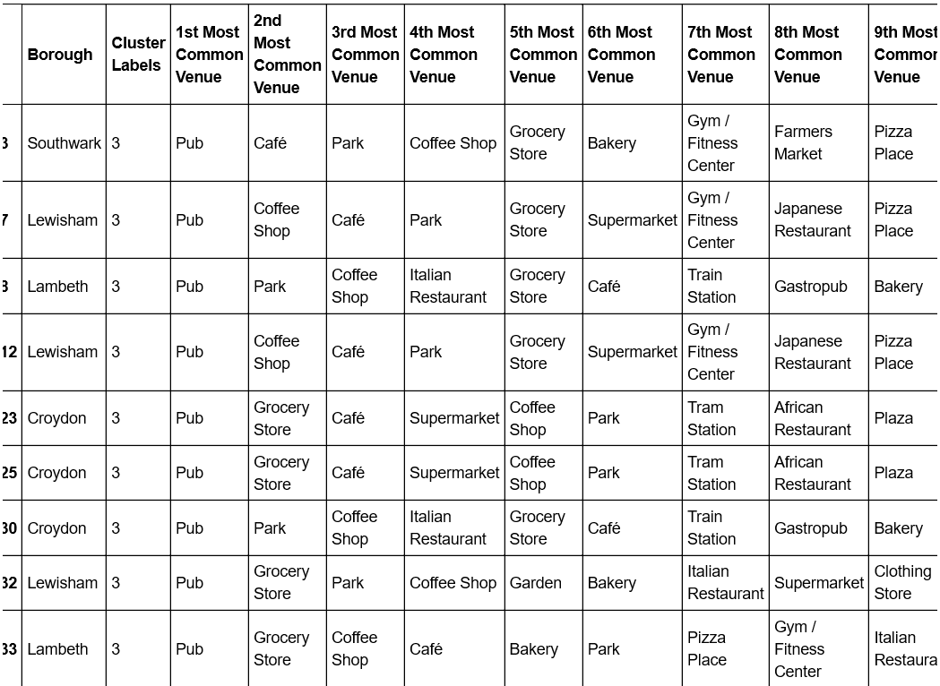
Results Cont……..
Cluster 4:
The fourth cluster has neighbourhoods which consists of venue Pubs, Park, Grocery Stores.
.

Slide 11
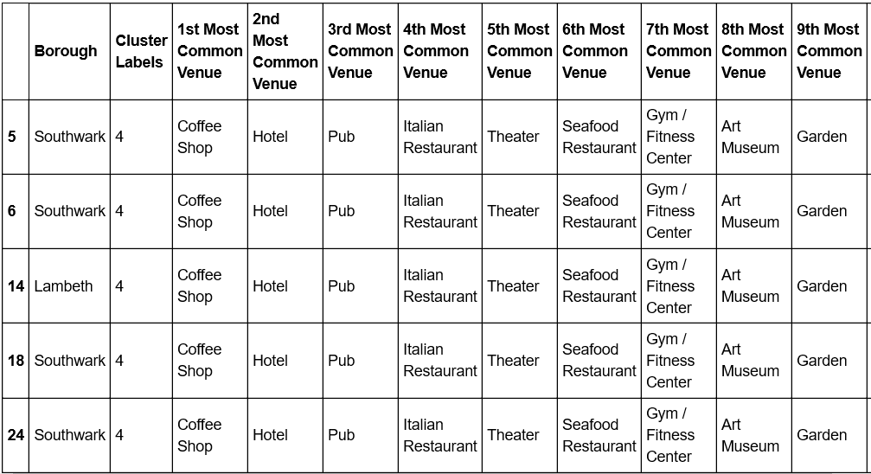
Results Cont……..
Cluster 5:
The fifth cluster has neighbourhoods which consists of venue Coffee Shop, Pub, Hotel

Slide 12
5. Discussion and Conclusion:
Its been visible from cluster 3 and 4 that Indian Restaurant can play vital role in Restaurant competition and very good chance to set up.
Their proximity to other amenities and accessibility to station are huge. These 2 clusters do not have top restaurants that could rival their standards if they are created.
The chances to resources needed is quite high as Lewisham and Lambeth. In conclusion, this project would have had better results if there were more data in terms of per capita income data within the area, traffic access, corporates of more venues exploration with the Foursquare.
Getting the ratings and feedbacks of the current restaurants within the clusters would have helped in providing more insight into the best location

Slide 13
Thank You

